Slide 1
Value Stream Mapping
A technique that lets you analyze the current state in order to improve the future state
A visualization tool with roots in lean engineering
A systems view of your enterprise As Is
Notes:
What I want to talk about today is value stream mapping.
I hear a lot of people talk about Value Stream Mapping, but I think few people in enterprises understand the idea, or in the case of some manufacturing companies they understand the idea with physical factories but not digital work.
Value Stream Mapping is
A technique for understanding current state so you can improve
It’s a visualization technique
And it’s a system view.
It comes to us from lean engineering
[More specifically:
It has its roots in flow modeling going back as early as 1918, in Installing Efficiency Methods, by Charles E. Knoeppel
It was later popularized and most known for its association with Toyota Production System through the writing of Shigeo Shingo, although it was not popularized in English until around 1980 when his books were translated and later took off as a part of a Lean manufacturing technique]
So I am going to go through a quick overview of value stream concepts and then we will dive right into how to run one. If you have more questions on the basics, I’ve included some fact sheets in the conference slack channel

Slide 2









Key Idea: Systems Thinking
Test
Design
Support
Customer
Audit
Security
Development
Product
Operations
Notes:
Concept one is Systems Thinking. Those of you who have read The Phoenix Project will recognize this as the first way.
But in summary – this is how your enterprise goes from a “Concept to Kaching” – from idea to in production.
Many organizations do design thinking I the business, agile optimization for development, and migrate their operations to the cloud… but this is designed to be, no kidding, the entire enterprise system.
[The Phoenix Project: A Novel About IT, DevOps, and Helping Your Business Win
by Gene Kim, Kevin Behr, George Spafford]

Slide 3








Key Idea: Identify and Eliminate Waste
Defects | Waiting | Extra Features | Non-Utilized Talent
Re-Learning | Handoffs | Task Switching | Partially Done Work
‡Mary and Tom Poppendieck, Lean Software Development: An Agile Toolkit, 2003.
Notes:
The main goal of visualizing our current state value stream, is so we can identify and eliminate waste
Waste are things like defects, waiting, extra features, etc
‡Mary and Tom Poppendieck, Lean Software Development: An Agile Toolkit, 2003.
See also Mary and Tom Poppendieck, Implementing Lean Software Development. “The 7 wastes of software development”
Defects
Waiting (Delays)
Extra Features
Non-utilized talent
Relearning
Handoffs
Task Switching
Partially Done Work

Slide 4
Key Idea: Implement Counter-measures
Automate
Simplify
Refactor
Lower Work In Progress
Level out workload
Reduce Setup Time
Standardize
Notes:
Then the last key idea is that the process we use to eliminate that waste is to implement countermeasures
This seems like stating the obvious, but identifying waste without giving the team a chance to improve it is just an exercise in killing employee morale

Slide 5
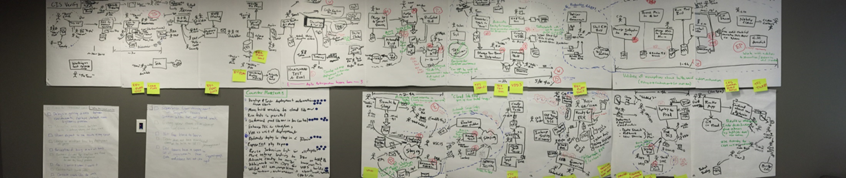
A full value stream example…
Agile
Development
Requirements
Everything else done to Deploy….

Slide 6

Let’s Run a Value Stream Mapping Session!
Notes:
Ok so lets run a virtual value stream mapping session, we are going to dive into the process

Slide 7
Step 1: Pick the Feature (5 Rs)
Recent
Real
Reach
Representative
Road-tested
Notes:
Now to model your value stream, we need to honor reality. So its important we pick a system feature that has the five Rs:
Recent (Deployed within last three months)
Real (Business Impact, not just an enhancement),
Reach (broad system concerns and covers broad value stream)
Representative (typical feature, not emergency patch or special circumstance)
Road-tested (In production, ideally with user feedback and telemetry)
Now to give you a concrete example so you have an idea – one team I worked with selected a resent update that enabled a mobile application-based payment process. It was deployed about a month before the session occurred, it was intended to reduce the time for a customer in the system, it covered everything from the front end of the application to the back end business logic, and it was representative in that – a lot of recent work for this team was in making their system more mobile friendly. And, we had some data from customer usage of the feature too and from our work systems such as Jira and ServiceNow so we could put real dates and metrics on how the organization went from idea to deploying this feature.

Slide 8
Step 2: Identify the Value Stream People
Just a few job titles you might need to include…..
Business Owner
Product Owner
Business Analyst
UX Design
Architect
Tech Lead
Developer
Tester
Systems Engineer
DevOps Lead
Security
Legal/Audit
Quality Assurance
Operations Manager
Network Engineer
Database Engineer
Cloud Architect
Site Reliability Engineer
Production Support
Customer Service
Notes:
Step two – rather obvious – is you need to identify and invite the people in your value stream.
Now, you selected a good feature
So invite the SPECIFIC people who were involved in THAT feature. You don’t have to invite every single person, but make sure you cover enough roles and perspectives.
Also remember– this is an exercise in creating a shared visualization about your system of work. So the business owner might say they are too busy or they don’t really know much about how you IT people do what you do – INVITE THEM.
Going back to the first key idea: This is a whole system exercise. So at a minimum, value stream mapping absolutely needs to include your business leaders and at least one person from each key organizational roles involved in delivery of the system
This might seem like a long list. And it could be. But I’m going to remind you about step one - because this is how you know who in these roles you need to select. You will have picked a single feature, and most likely not everyone in your enterprise was directly involved in that feature – so when you select the tech lead, select the one from that team, and the database engineer from THAT feature, and the on call lead for Operations the day it was put in production. And you don’t need every developer on the team, bud ideally the one who did the most coding on the specific feature we are going to be discussing. Now its possible in a large enterprise that this list could get really long – but ideally this is not more than 10-15 people. If it reveals 20-30 people by all means invite them all – you probably have a lot of waste and handoffs to work through…

Slide 9
Step 3: Place activities on timeline
Colors = Roles
Mon
Tue
Wed
Thu
Fri
Card = details
Activity
Effort
Start
Finish
Notes:
So then you place activities on the timeline
Now in an in person value stream mapping exercise we sometimes draw full process boxes. And, if you have three days and a room full of people this is fine. But I am assuming you have a few hours and you’re stuck on Zoom with a virtual brainstorm tool so let me give you a few simpler ideas
For one value stream session, we were trying to model all the team activities and handoffs. Before the meeting I had everyone catalog from the work system the tasks they did, and when they did them (start time, finish time, and then their estimation of actual effort). If two teams worked together we stacked the cards on top of each other.

Slide 10
Step 3: Place activities on timeline
Colors =
manual vs automated
Plan
Analysis
Dev
Test
Stage
Ops
Card = details
ROLES
Activity
Start
Finish
Notes:
Now another model is to capture your “SDLC” – especially useful if you have some fierce stage gate approvals to try to tackle, in this case those stage gate events serve as the silos we’re capturing work around. In this case I had a team trying to figure out how to better automate compliance and security approvals, so this modeled their mental timeline.
I have a few more examples in the handouts – this is where the art meets the science
If I can just give one tip here –Use colors think about what I will call the macro/micro – the details – the micro – will be on the cards, but the macro is what it shows you when you squint and zoom out – so think about what big picture idea you need the team to visualize – in this case – lots of automation in the middle of the process not very much in the start and end.

Slide 11

Step 4: “The Conversation”
Notes:
Step 5 – can’t skip this – the conversation
You can absolutely do steps 1-4 asynchronously, and offline and in parallel before meeting in person but you can not have a successful value stream mapping session without a conversation. It matters that you talk it out, it matters that everyone in the room is looking at the same picture, it matters that everyone in the room trusts this value stream is an honest visual representation of how work gets done

Slide 12
Step 5: Identify the wastes
defects
Partially Done Work
waiting
Extra processing
Notes:
Once you agree you have a true picture of how the work happened, identify the waste. If you have a shared board just have folks circle or flag or whatever the waste they see and write which kind of waste or why they think its waste.
You’re going to want to have more conversation here by the way. For example, the development team things the quality assurance team rebuilding the system that they already built is extra processing, the QA team sees it as an important independent verification. And where you might need to facilitate this process is that it probably is extra work, and there is some additional waste earlier in the system where a build is created but is not verified to QA standards, maybe because it ran on a developer laptop – so these are just examples on where you need to conversation to guide the visual

Slide 13
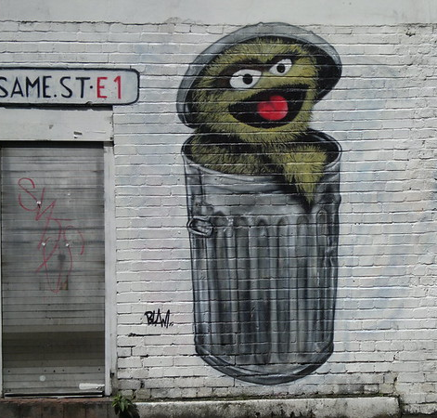
Step 6: Prioritize Waste
Bad news: You probably have a lot of waste.
Where to focus?
“Most annoying waste award”
Notes:
Next, you need to prioritize. You probably have a lot of waste. Way too much
Try something fun like most annoying waste awards or some other voting technique.
More buy in needs to happen here, which is part of making sure the team owns the improvements

Slide 14
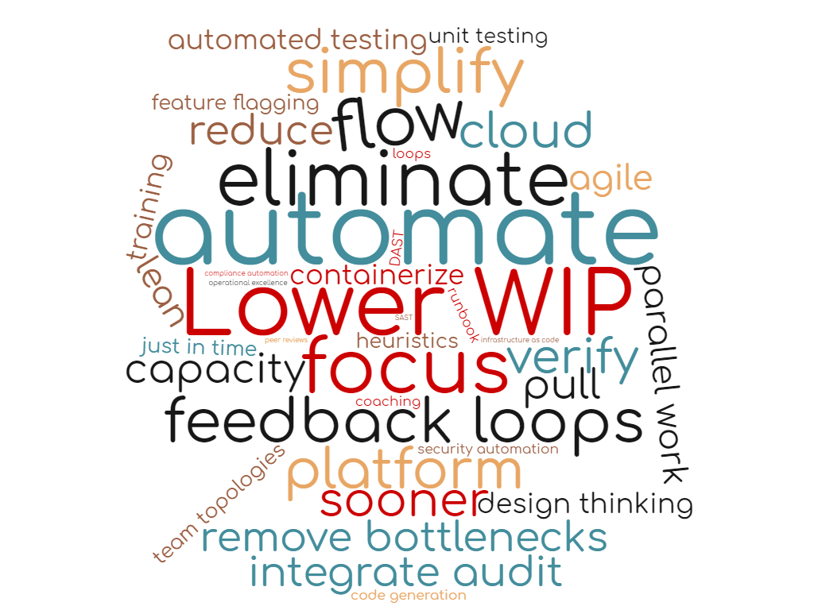
Step 7: Countermeasure Brainstorm
Target Process: Area | Goal: Automate all the things!
Current State | Baby Steps
Future State | Issues/Risks
How will we know our improvement worked? | Owners
Notes:
Now with your prioritized waste, develop countermeasures.
I like using a lean canvas for this part.
Capture the Current State from your Value Stream Map
Describe what you want the future state to look like
Come up with some way to know and measure when you achieve future state
Describe the countermeasures – we’ll call this “baby steps”
And any Issues or Blockers that prevent the countermeasures from being implemented
I have a handout on suggested countermeasures for the forms of waste that you can use here too, but this is where I hope you can encourage your teams to imagine boldly ways to improve their work

Slide 15
Step 8: Baby Steps
How Broad is this Improvement | How Bounded is this Improvement?
How much Effort is this improvement? | How Difficult is this improvement?
Inside a Team
Across Teams
Multiple Teams
Multiple Businesses
Internal
External
Regulatory
Low
Moderate
High
Intense
Simple
Compound
Complex
Visionary
Notes:
Now make sure you turn these countermeasures into baby steps. The good thing about the word baby step is that it reminds people to keep it small and simple.
So, you might need to take a big countermeasure and make it a smaller one.
Your goal when creating baby steps is to try to focus on steps that can be accomplished by a single, internal team with low effort and relatively simple engineering effort.
If you find most of your countermeasures can not be categorized in this way you might need to address more systemic problems – organizational design, outsourcing strategy, additional resources or training.
To give an example of how to scale this for your team – one session I did with a large team, the overall team was 200+ people but the specific feature team in the value stream session was a 20 person subset. Anyway, their first take on a countermeasure was to “automate security”, which is a big, complicated sounding requirement. We challenged this a little bit and came up with a more actionable task. There was an existing security tool that the organization already owned. Another team was running this tool in the development environment on a nightly basis. The task then became to see if this sub-team could use the same tool and also run it earlier in the process. Now it’s a task that a single team can do and its clear to everyone when we are done with the task, and we can clearly measure if doing that actually made things better for the team.

Slide 16
Step 9: Repeat!
Define Value
Map Value Stream
Improve Flow
Create Observability
Innovate and Improve
Notes:
Last step of course – repeat!
So this full value stream map is part of a DevOps lifecycle- you need to define the business value you are trying to create, create the value stream map, improve flow by eliminating waste, create observability and feedback loops in the system and use these to continue to improve the system.
Now, to that end, I think the value stream tool is really useful in limited but impactful doses.
As an organizational Lesson: Some time ago I was running a large program with four portfolios, and I did sessions with teams across all four portfolios. What I have discovered is in most organizations problems are common/shared, and somewhere around the 3rd workshop we were seeing common, recurring patterns with teams. I mean there is some utility in creating this shared visual for teams to engage but bear in mind, for most organizations you are going to find a lot of issues in common
Second on frequency – about every 6 months is the right ratio. (You should be completing/removing waste at least that fast, but some of these issues may table 6-8 weeks to resolve or more). A good gage on if a team is ready to repeat the process is if they have hit a plateau and need a fresh look at how to get better.

Slide 17
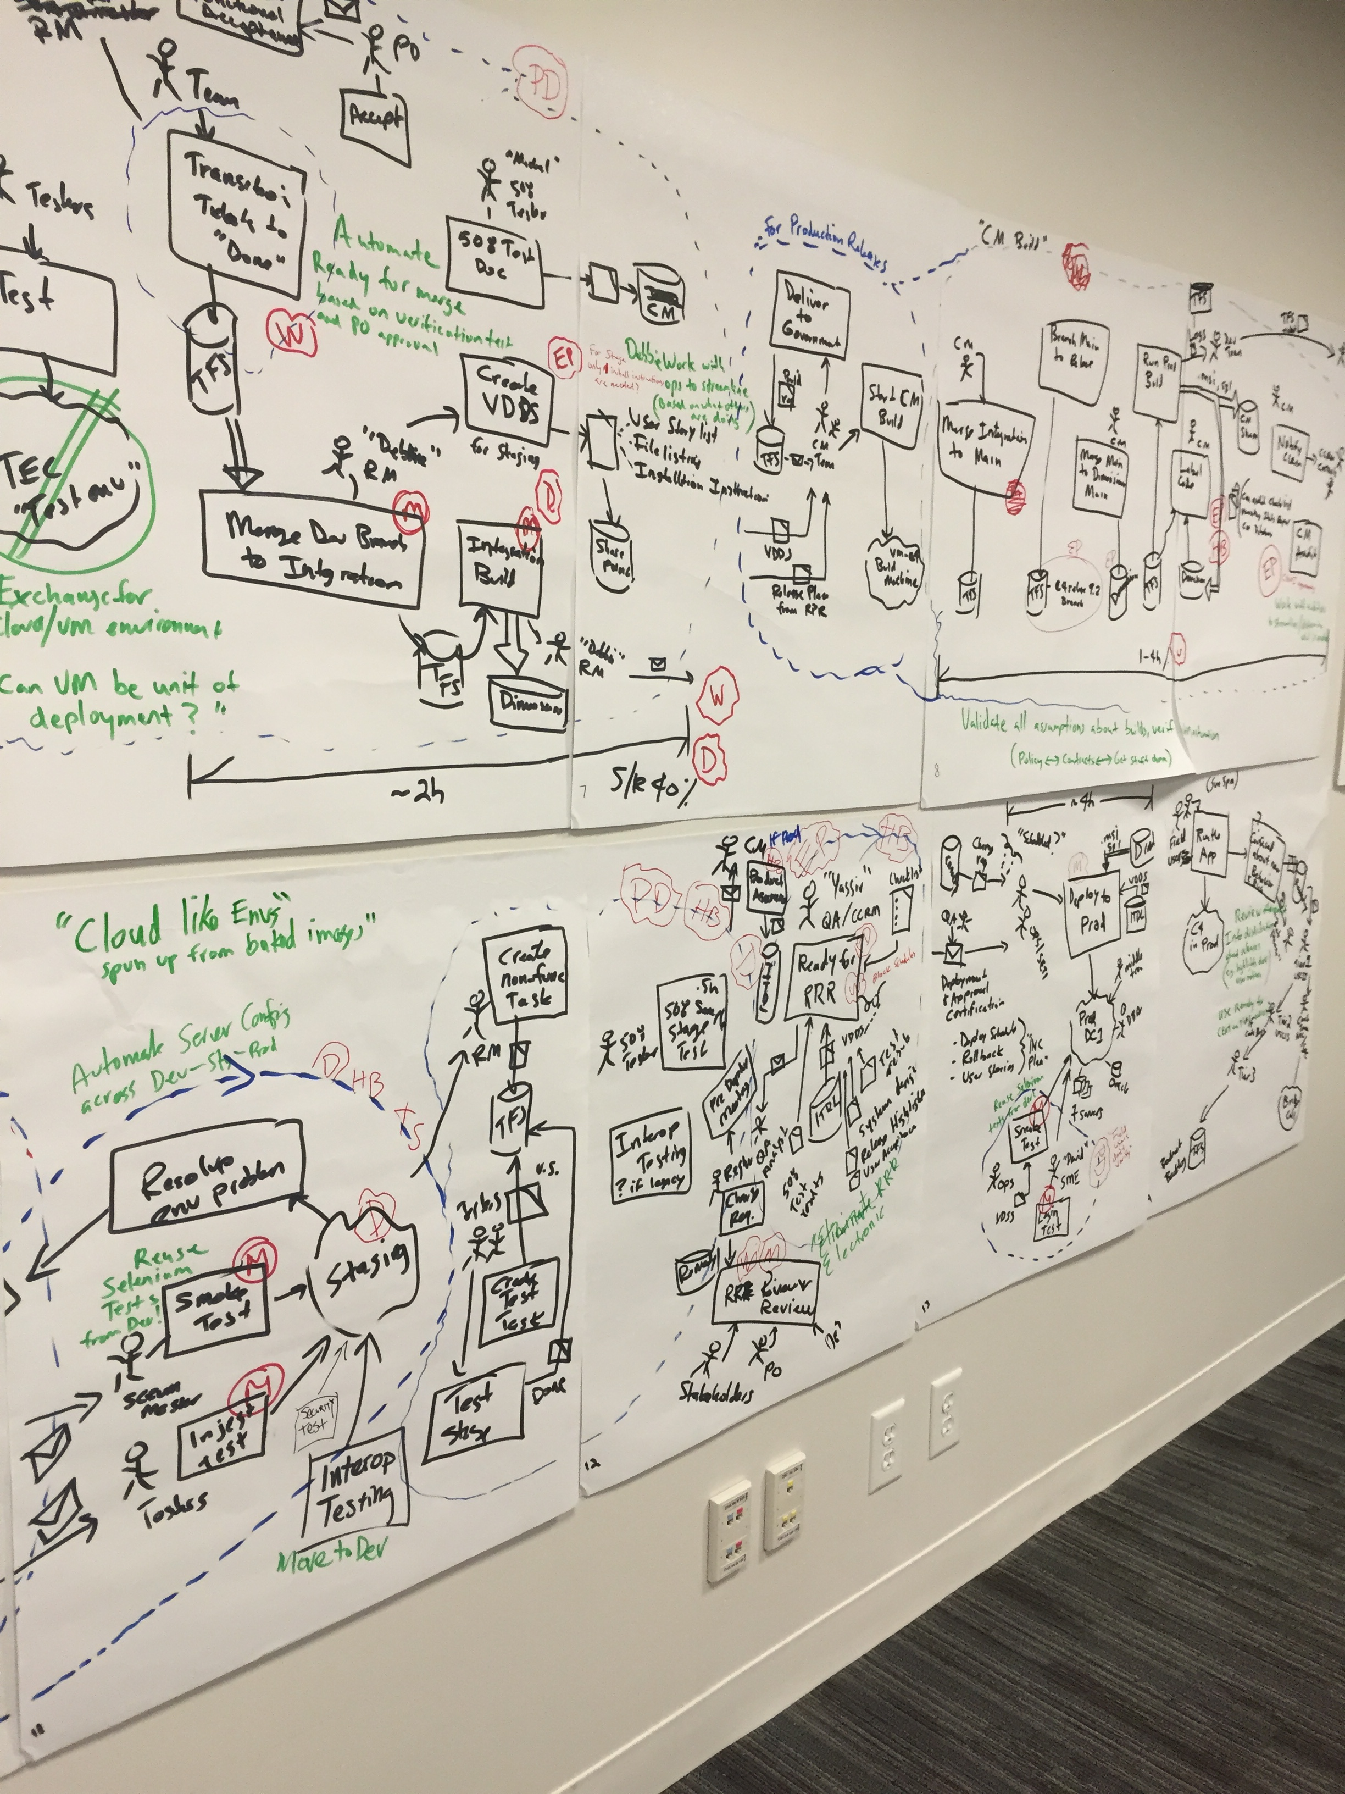
Re-creating this virtually:
Team members who represent all the roles in the value stream
A shared visual capability
A neutral facilitator
Actual work to model
Ability to make non-verbal reactions known to facilitator
Notes:
In person wall – Mural Board, LucidChart, Google Drive file, Microsoft Teams, etc
Long Duration (2 Days vs Hours)
Ask participants to do homework beforehand
Some asynchronous updating of value stream
Facilitator – doesn’t have to be a professional, though, that helps – but does need to be a neutral person in the value stream. (e.g. not someone involved in some aspect of delivery)
Ability to “Read the room”
Deliberate polling
Truthometer

Slide 18




How can I help you?
Please share with me!
Your organization’s experience with VSM
Have you run a virtual VSM? What tips can you share?
How can I help you?
 | Paula Thrasher
 | @paula_thrasher
 | www.linkedin.com/in/pthrasher/
 | calendly.com/paula-thrasher
Notes:
Paula Thrasher
@paula_thrasher
https://www.linkedin.com/in/pthrasher/
https://calendly.com/paula-thrasher

Slide 19





